Slide 1
FOSS
Discovery Environment
Tool Integration and
App Building
June 7, 2019
Amanda Cooksey

Slide 2
What we will cover
How to integrate your BioContainer as a tool in the DE
How to build and app for your tool
How to share your tool or make it public

Slide 3
Review of terminology
Image: self-contained, read-only ‘snapshot’ of your applications and packages, with all their dependencies
Container: a running instance of your image
Image registry: a storage and content delivery system, holding named images, available in different tagged versions
Docker: a program that runs and handles life-cycle of containers and images
CyVerse tool: Software program that is integrated into the back end of the DE for use in DE apps
CyVerse app: graphic interface of a tool made available for use in the DE

Slide 4

CyVerse Discovery Environment
Provide graphic interface for common analysis tools
DE tools are Dockerized
Users can integrate tools
And build apps
CyVerse tools and apps
Keep them private
Share them with collaborators
Make them publicly available

Slide 5
Tool Integration in the DE
Skip to Porechop usage

Slide 6
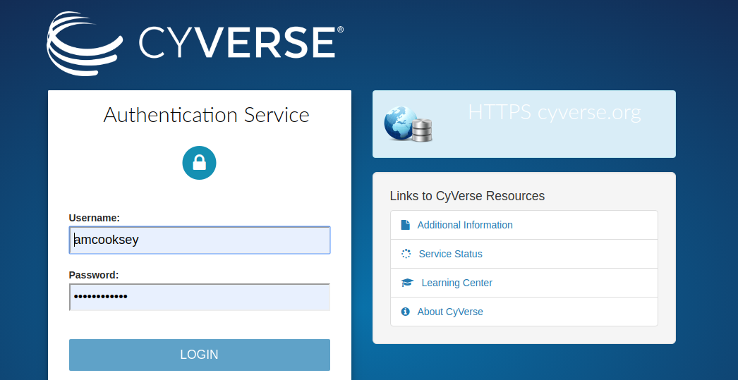
DE
Next step

Slide 7
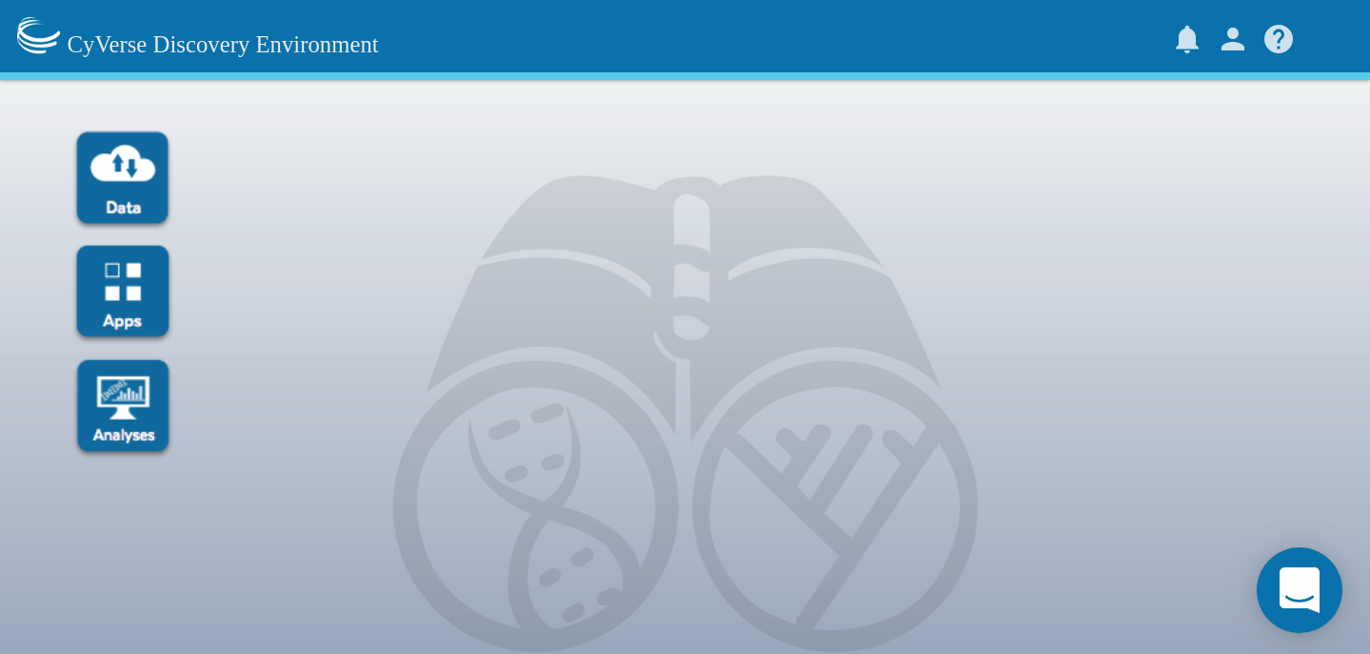

Slide 8
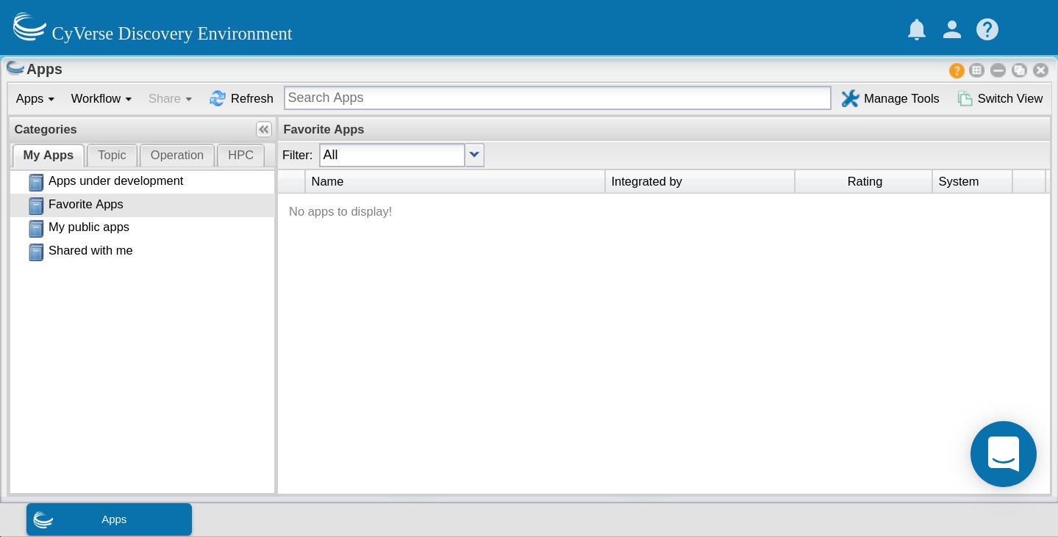

Slide 9
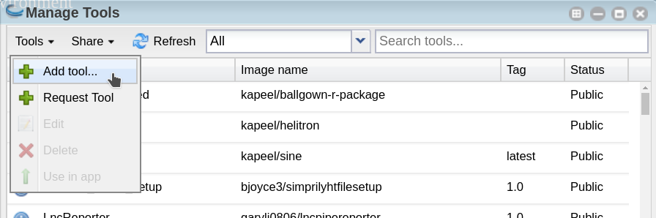

Slide 10
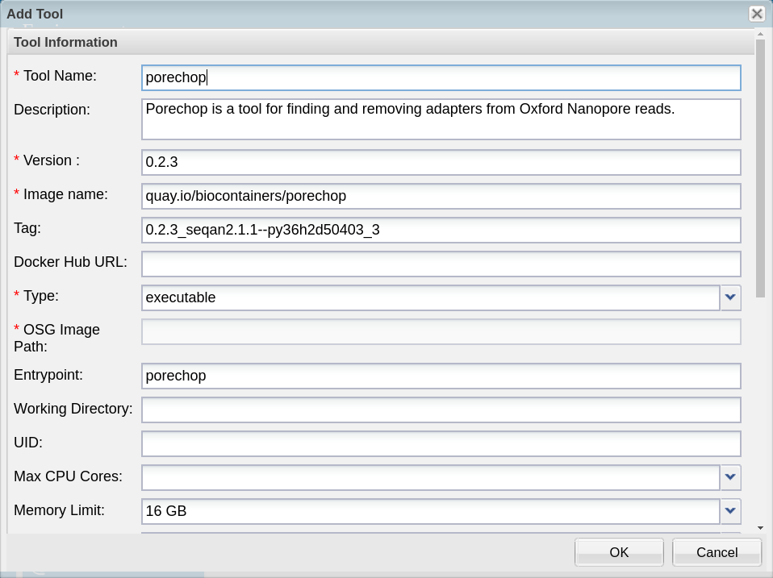
Be sure to include ‘entrypoint’

Slide 11
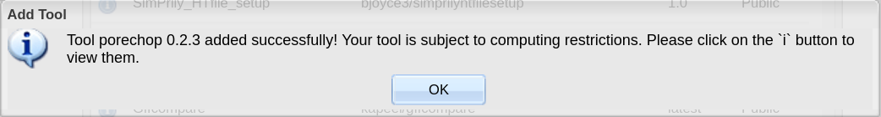

Slide 12
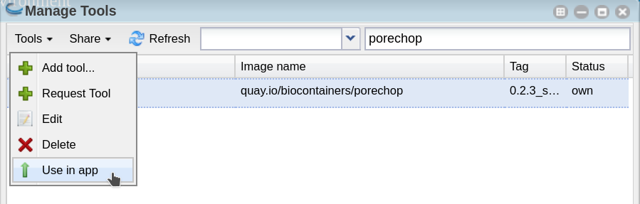

Slide 13
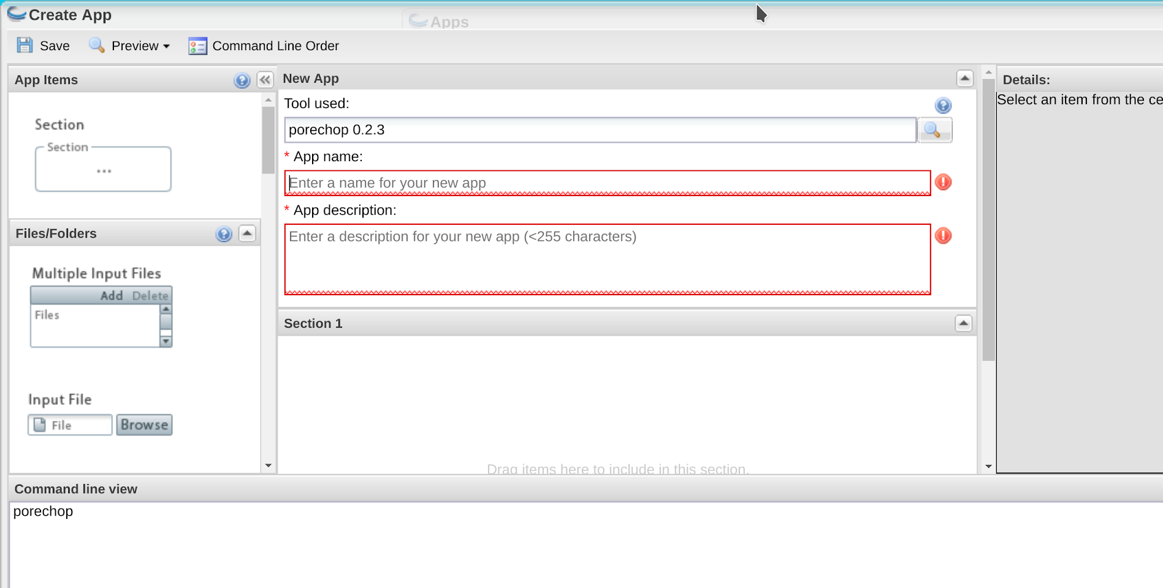
Enter a meaningful ‘app name’ and ‘app description’ so that other users can tell what it is and what it does.

Slide 14
usage: porechop -i INPUT [-o OUTPUT]
[--format {auto,fasta,fastq,fasta.gz,fastq.gz}] [-v VERBOSITY]
[-t THREADS] [-b BARCODE_DIR]
[--barcode_threshold BARCODE_THRESHOLD]
[--barcode_diff BARCODE_DIFF] [--require_two_barcodes]
[--untrimmed] [--discard_unassigned]
[--adapter_threshold ADAPTER_THRESHOLD]
[--check_reads CHECK_READS] [--scoring_scheme SCORING_SCHEME]
[--end_size END_SIZE] [--min_trim_size MIN_TRIM_SIZE]
[--extra_end_trim EXTRA_END_TRIM]
[--end_threshold END_THRESHOLD] [--no_split]
[--discard_middle] [--middle_threshold MIDDLE_THRESHOLD]
[--extra_middle_trim_good_side EXTRA_MIDDLE_TRIM_GOOD_SIDE]
[--extra_middle_trim_bad_side EXTRA_MIDDLE_TRIM_BAD_SIDE]
[--min_split_read_size MIN_SPLIT_READ_SIZE] [-h] [--version]
Square brackets means the [option] is not required
The only required option for Porechop is -i INPUT

Slide 15
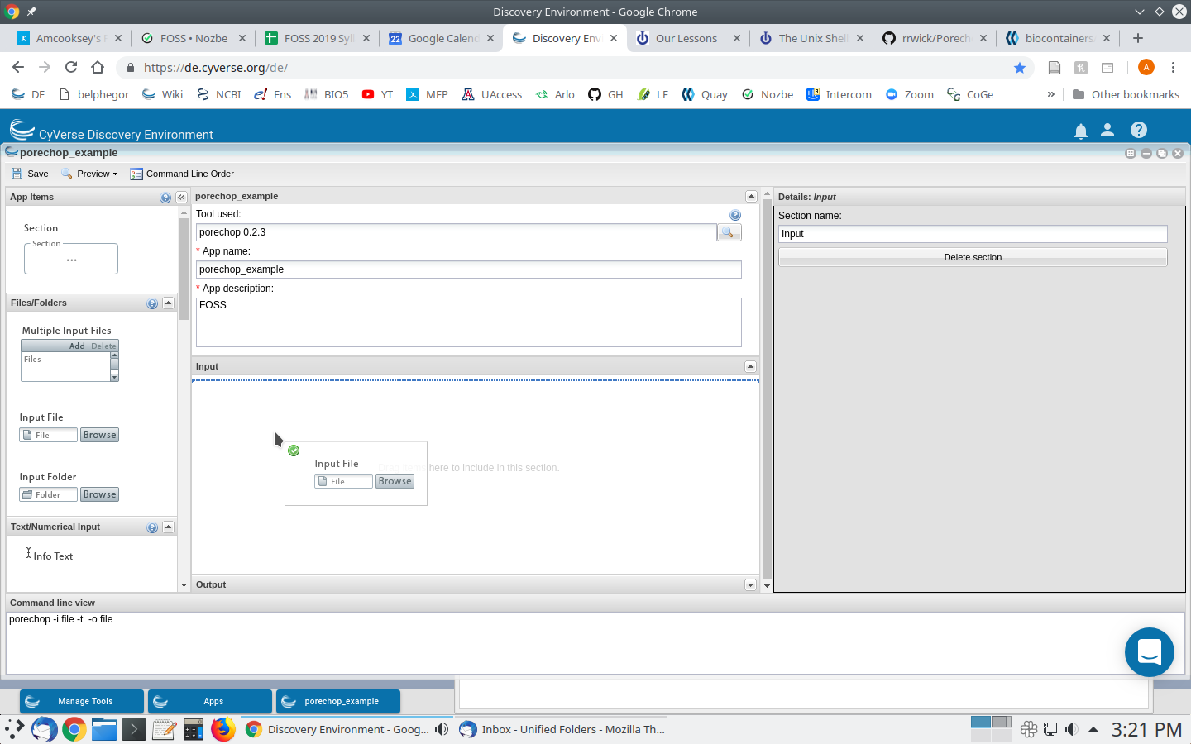
Drag and drop features from the left pane into the center pane.

Slide 16
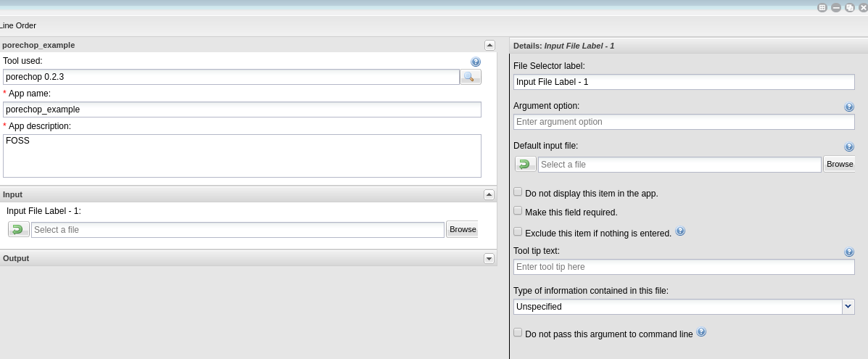
Use the right pane to add/change details of the selected feature in the center pane

Slide 17
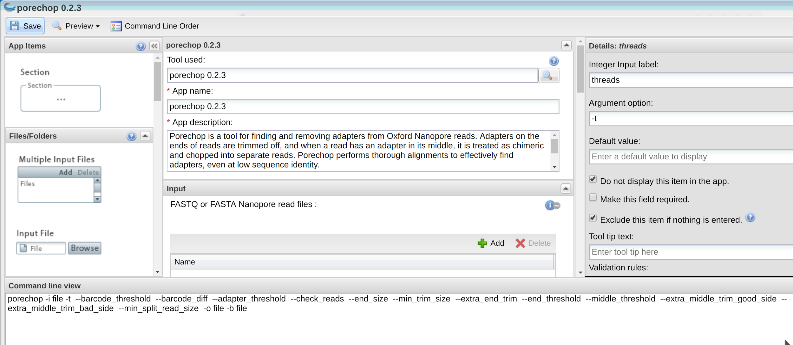
This is the public Porechop app with all of the options exposed

Slide 18
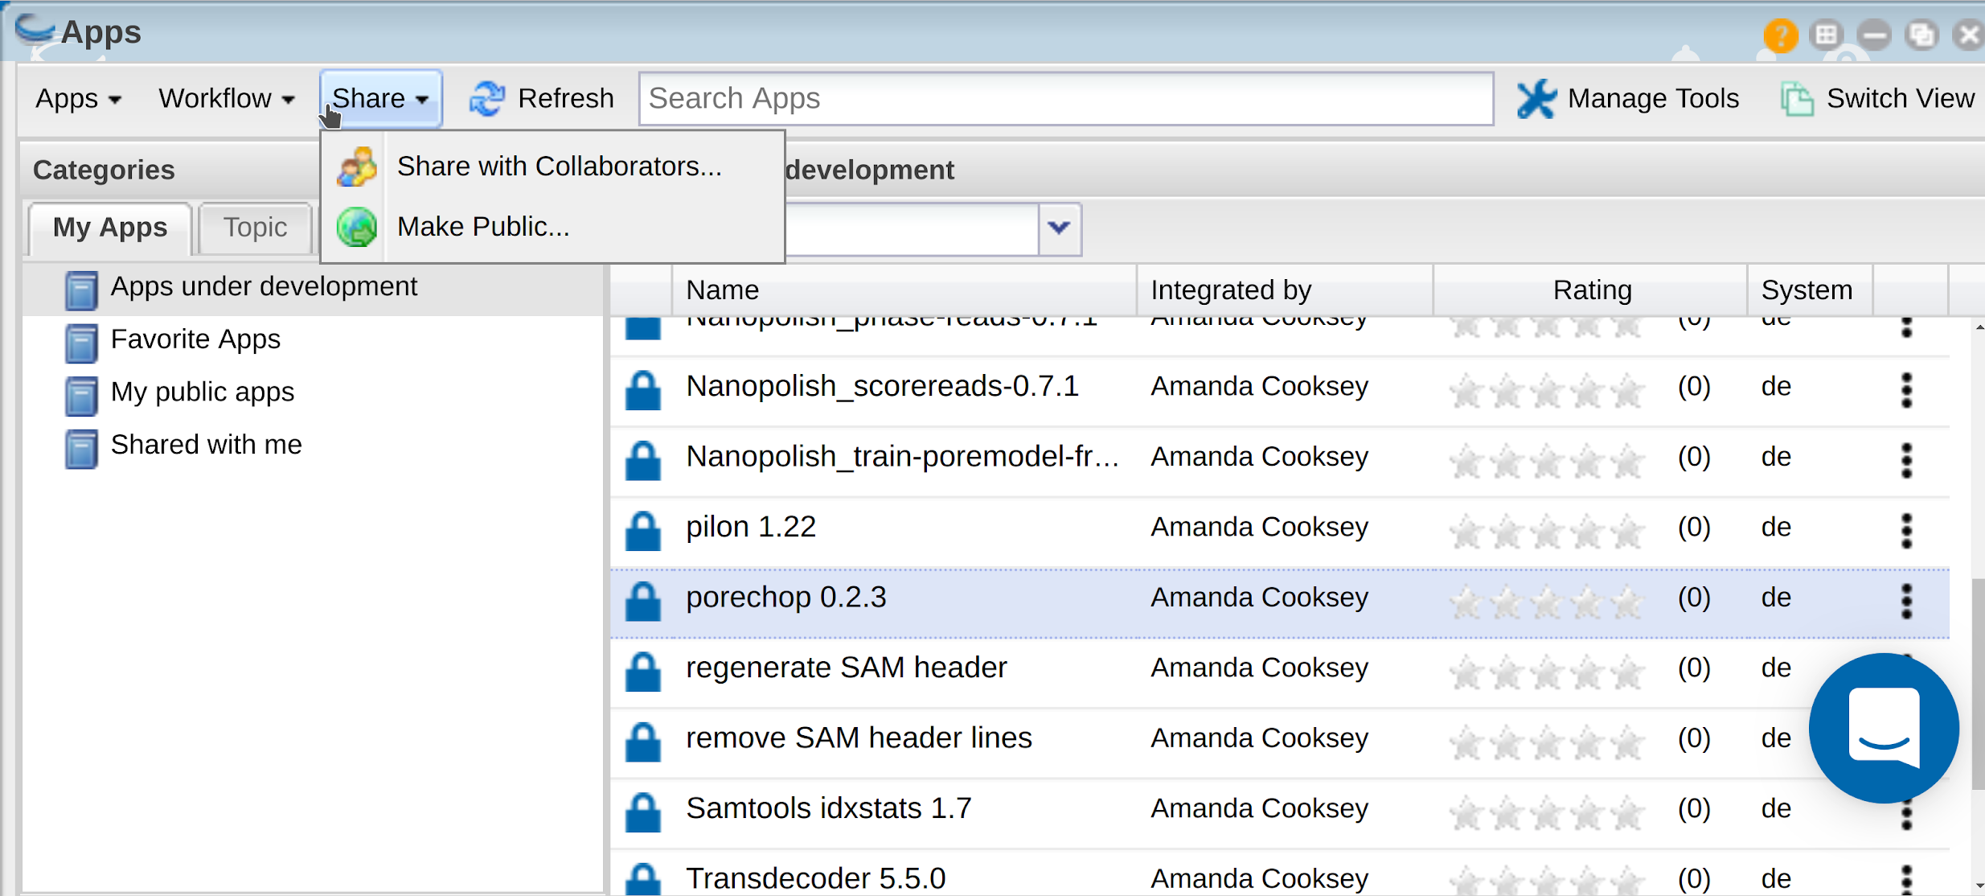
Share your app or make it public

Slide 19
Publishing your app
Public apps require documentation
There is a CyVerse Wiki page for every app
Public apps require example data
Make a folder here:
/iplant/home/shared/iplantcollaborative/example_data
Choose small example files

Slide 20
Information you need to publish your app
Topic--selected from a controlled vocabulary (eg. transcriptomics)
Operation--selected from a controlled vocabulary (eg. mapping)
Example data folder
Brief description of inputs, required parameters and outputs
Wiki documentation page--the app doc page you made
Tool documentation page--the original documentation page provided by the group that made the tool (frequently a GitHub page)

Slide 21
Steps to integrate a BioContainer in the Discovery Environment
Find BioContainers image at Quay.io or the BioContainer Registry
Pull your image with Docker
Run container with appropriate data to test
Add tool in DE
Build app for tool
Share your tool/app as you wish

Slide 22
Useful Links and References
Bioconda GitHub Repository
BioContainers on GitHub
Quay.io
DockerHub
Biocontainers.pro
BioContainers Edu

Slide 23
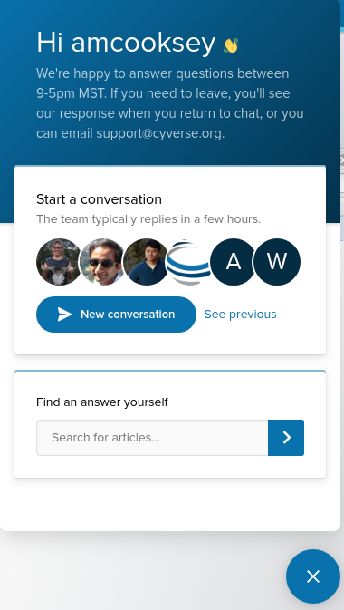

If you run into trouble Intercom.

Slide 24
CyVerse is supported by the National Science Foundation under Grants No. DBI-0735191, DBI-1265383 and DBI-1743442.

